Slide 2
Welcome
Catriona Marshall

Slide 3
Importance of Setting Goals
Nick Bishop

Slide 4
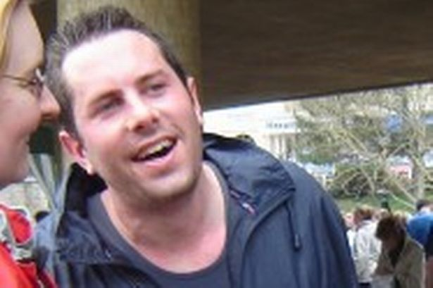
What is the secret?
Luck
Talent
Genes
Born with it
10,000 hours
Belief (90%/10%)

Slide 5
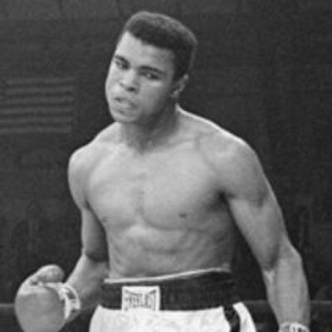
“I am the greatest”

Slide 6
Affirmations
Powerful Statements
Doing Words…Finishing…Crossing the line…Setting a PB
Descriptive
Present Tense
Creating pictures
I AM…All about YOU!!
Twice daily for 30 days is all that it takes to change your beliefs!!

Slide 7
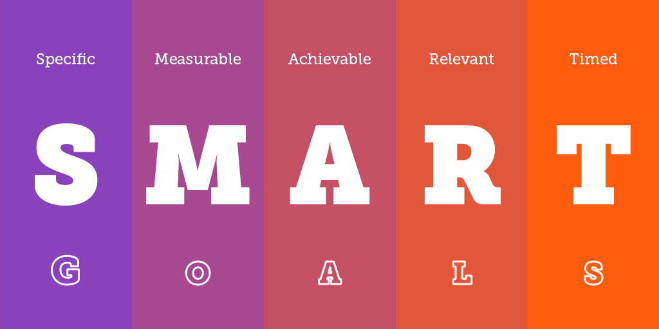
S.M.A.R.T – Used Properly

Slide 8
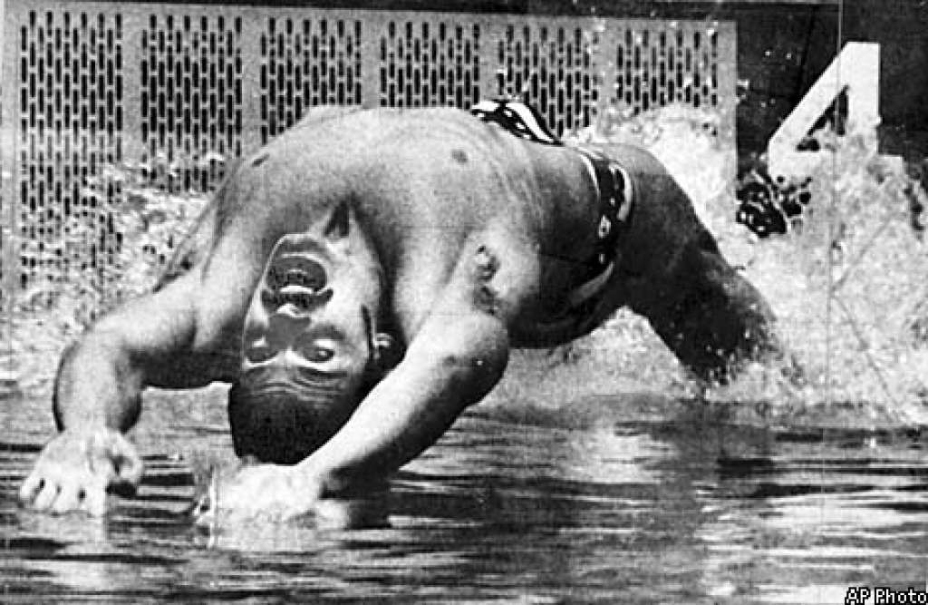
John Naber

Slide 9
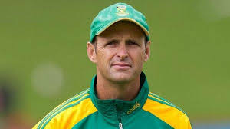
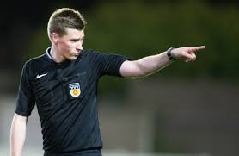
Goals and Vision
Short Term and Long Term
Celebrating success
Friday 5.00pm!
An athletes Mesocycle (eight weeks)
A seasons plan
How do you eat an elephant?

Slide 10
Keeping Fit and Injury Free
Angela Jackson

Slide 11
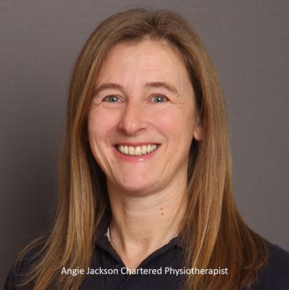
Angela Jackson
Chartered Physiotherapist 1987
Director of Physiofit Ltd, Alderley Edge since 1992
Physio to Cheshire Youth Cricket for 14 years
Special interest in developing young athletes and injury prevention after a career ending injury as a 16 year old halted my own sporting dreams
Mum of 2 who have both represented their country in their chosen sports
Running specialist

Slide 12
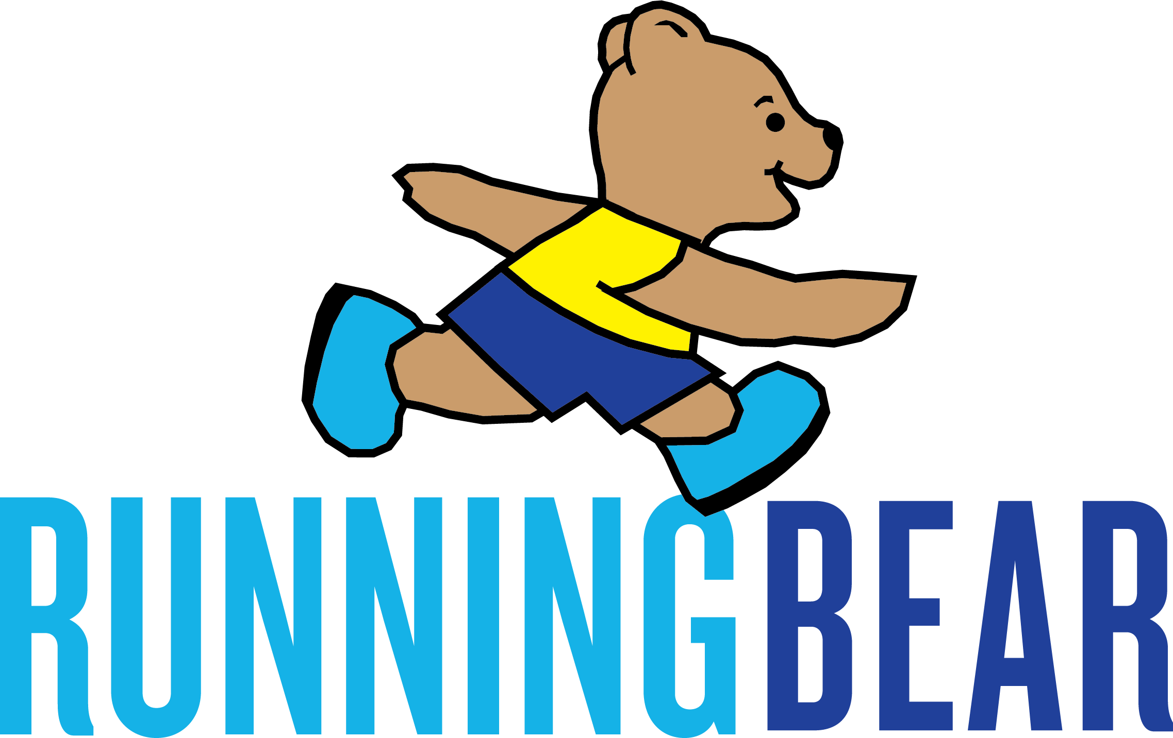
Running Bear and Physiofit

Slide 13
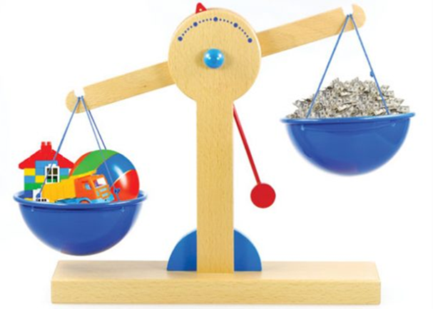
Too much too soon
Athletes who run more have fewer injuries…
providing that they have time to adapt.
Injury occurs with…
Excessive and rapid increases in training loads
Too little rest and recovery
Notes:
Athletes accustomed to high training loads have fewer injuries than athletes training at lower workloads.
Non contact injuries are not caused by training but inappropriate training
Excessive and rapid increases in training loads responsible for a large proportion of non-contact, soft-tissue injuries.

Slide 14
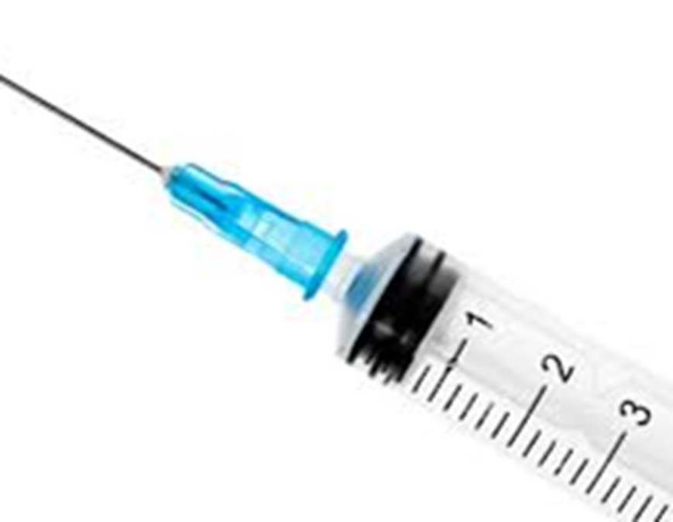
The injury prevention vaccine
Work out your running volume
Acute (this week) v chronic (last 4 weeks)
Average over last 4 weeks = 20 miles per week
This week = 30
30 divided by 20 = 1.5
Injury risk increases when over 1.2

Slide 15
Avoid spikes in work
No more than 10% increase per week
15% increase = 50% > risk of injury

Slide 16
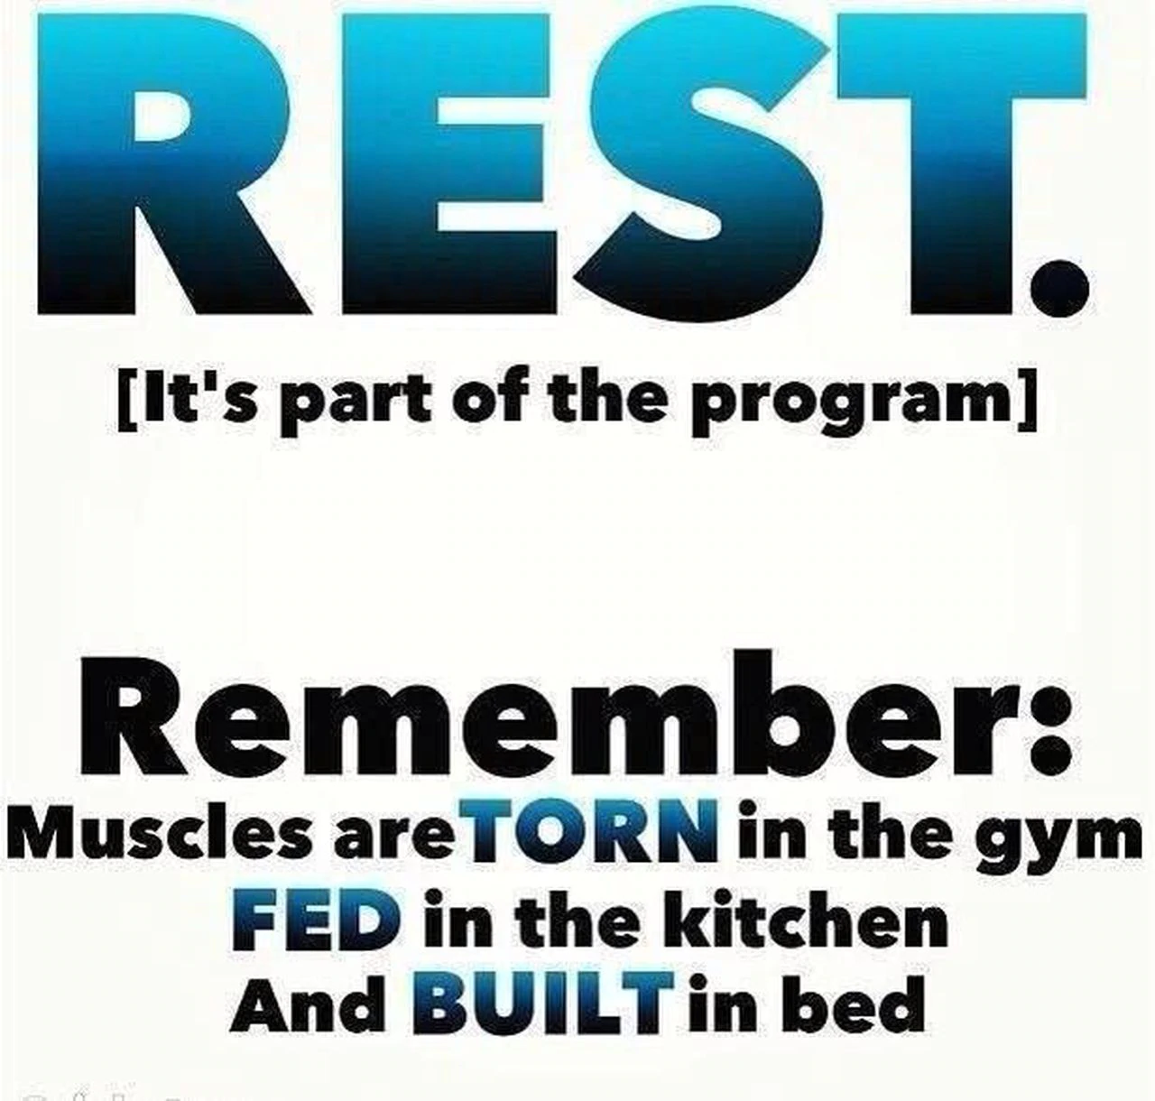
Recovery days are when we get stronger
Sleep:
Repair damaged cells and muscles
Build new muscles
Develop motor skills
Process things learnt in the day
Recharge the brain and the body

Slide 17
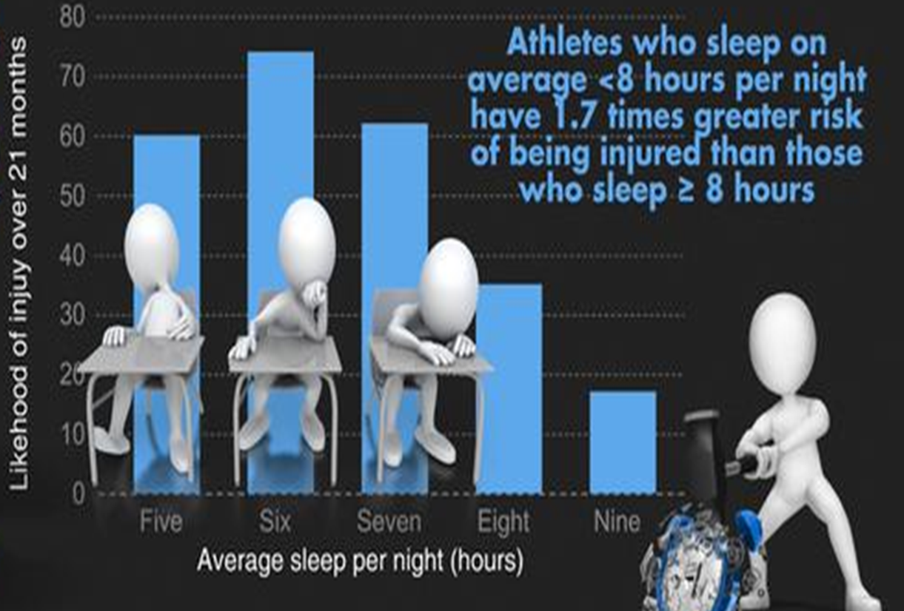
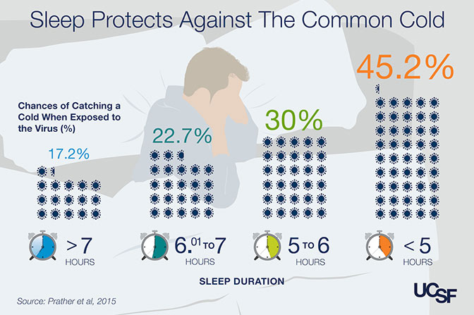
Lack of sleep lowers immunity and increase in infections as well as increasing injury risk

Slide 18
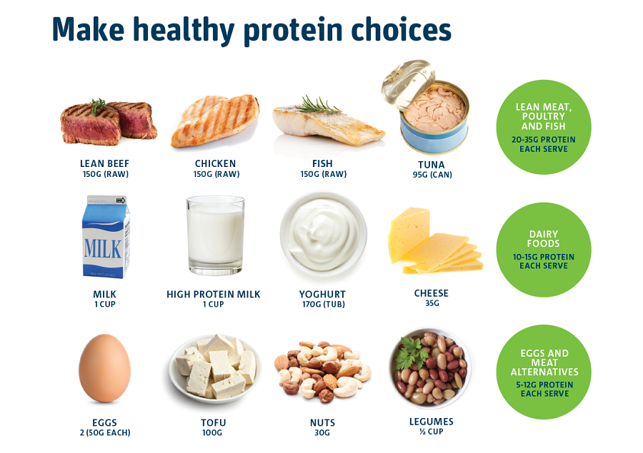
Recovery is not just about rest

Slide 19
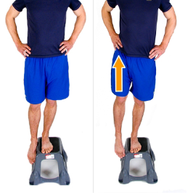
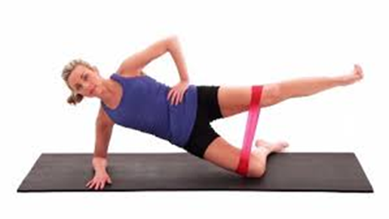
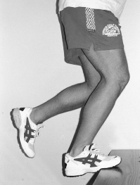
Stronger athletes get few injuries

Slide 20
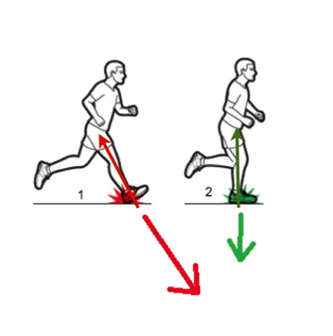
How many steps per minute is optimum

Slide 21
Excessive load on tissues =
Injury
Increase capacity of tissues to withstand load - get strong
Reduce load
Modify footwear
Change technique
Reduce risk of injury

Slide 22
Running Bear and Physiofit
Running Bear clients receive a 20% discount off their first treatment at Physiofit.
Physiofit clients receive 15% discount off a pair of trainers for each referral to Running Bear with a receipt dated within the last 3 months.

Slide 23
Nutrition for Training
Stephen Jones

Slide 24
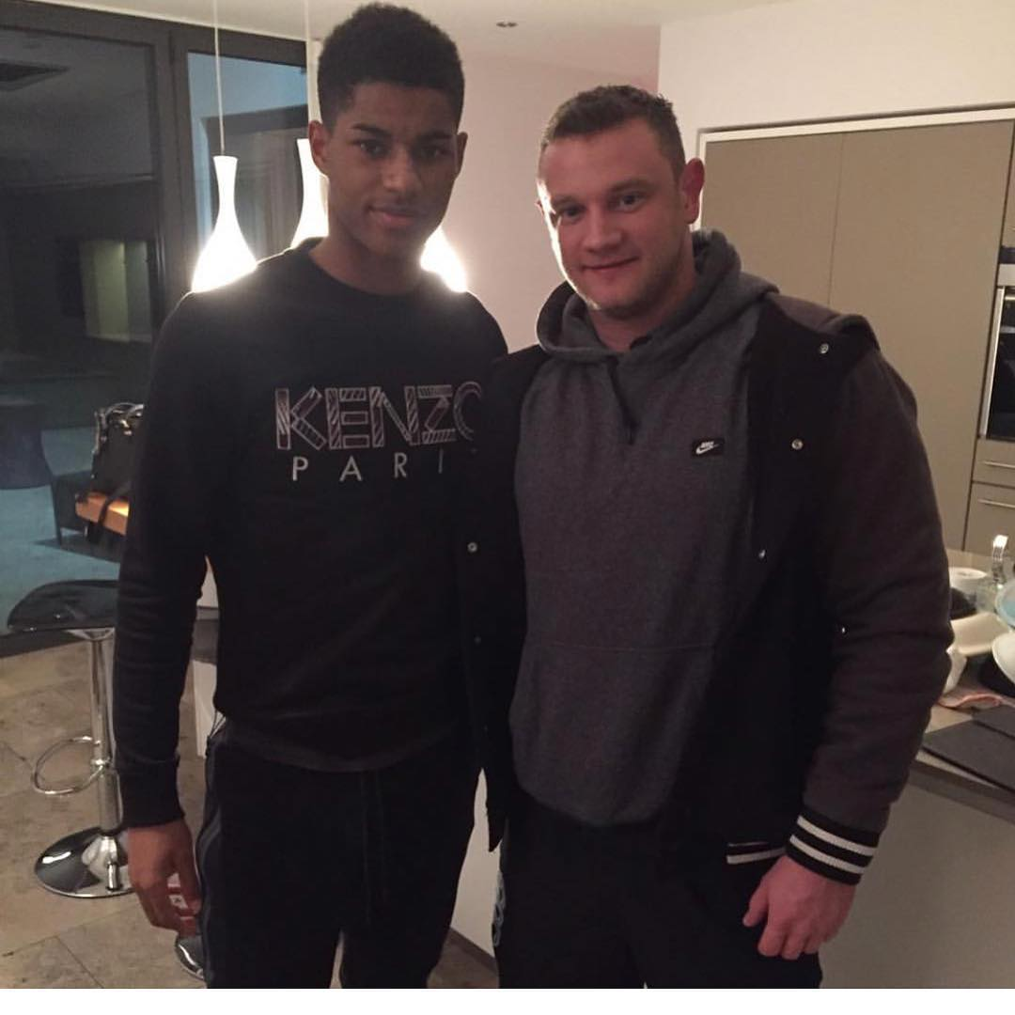
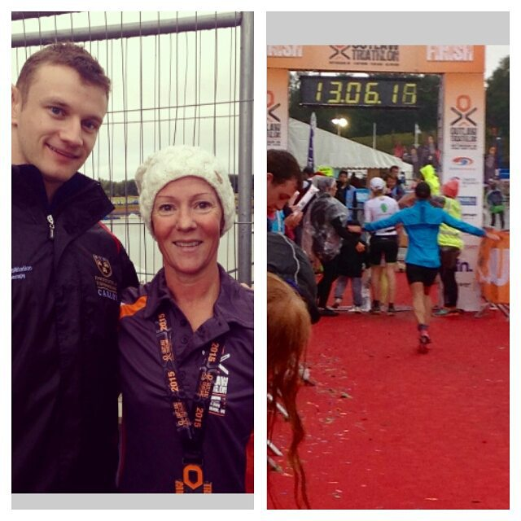
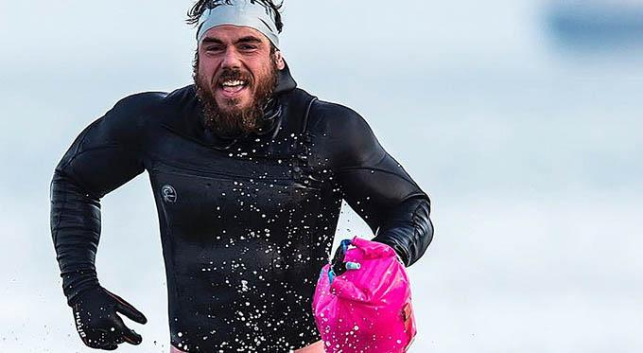
Who am I?
Ross Edgley- First person in history to swim all the way around Great Britain- 2000 miles and 157 days
Marcus Rashford- Manchester United footballer
Penny Scott- Iron(wo)man

Slide 25
What is Nutrition
General Nutrition
The process of obtaining the food necessary for health and growth.
Optimum Nutrition
Eating the right amounts of nutrients on a proper schedule to achieve the BEST performance and longest possible lifetime in good health.
Using nutrition to maximise health, happiness and well being

Slide 26
Knowing what to eat
How many calories do I need?
Protein goal per day
Split carbohydrates and fats accordingly
Track on how you feel, adjust accordingly
Lots of micronutrients

Slide 27
5 Top Tips for You
Increase your knowledge in the area of nutrition.
Have a clear goal in what you’d like to achieve.
Prepare in advance for the day – including weekends!
Track your food intake and the result it had on training.
Choose sustainability over EVERYTHING!

Slide 28
OTE Performance Nutrition
Annie Simpson

Slide 29
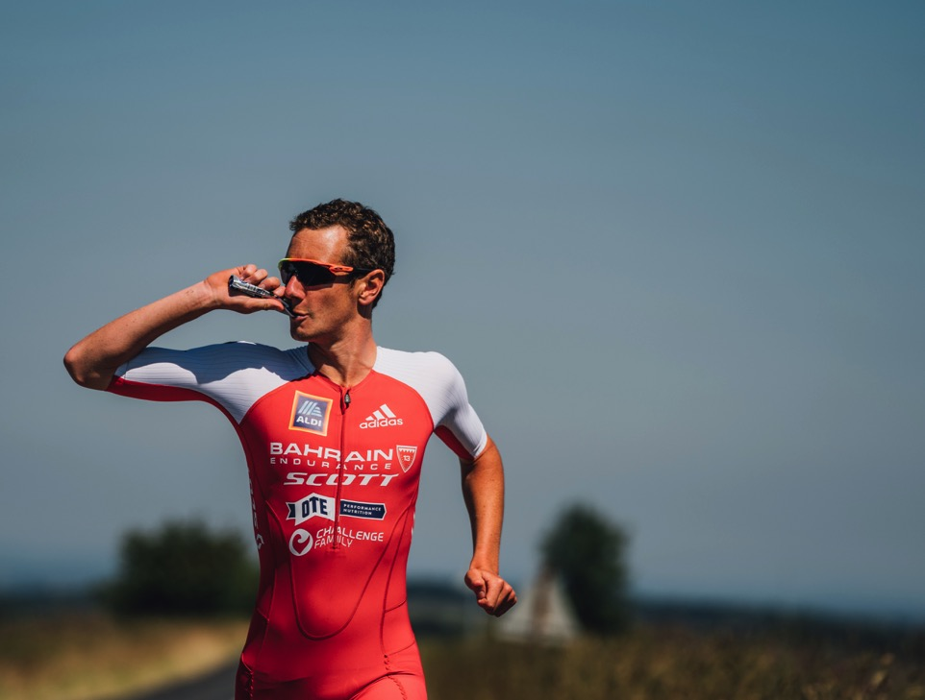
OTESPORTS.CO.UK

Slide 30
At OTE Sports we create sports nutrition and healthy snacks using natural ingredients.
Great tasting, kind on your stomach, easy to use and super effective, delivering performance when you need it most.
Put simply; Goodness in = Greatness out.

Slide 31
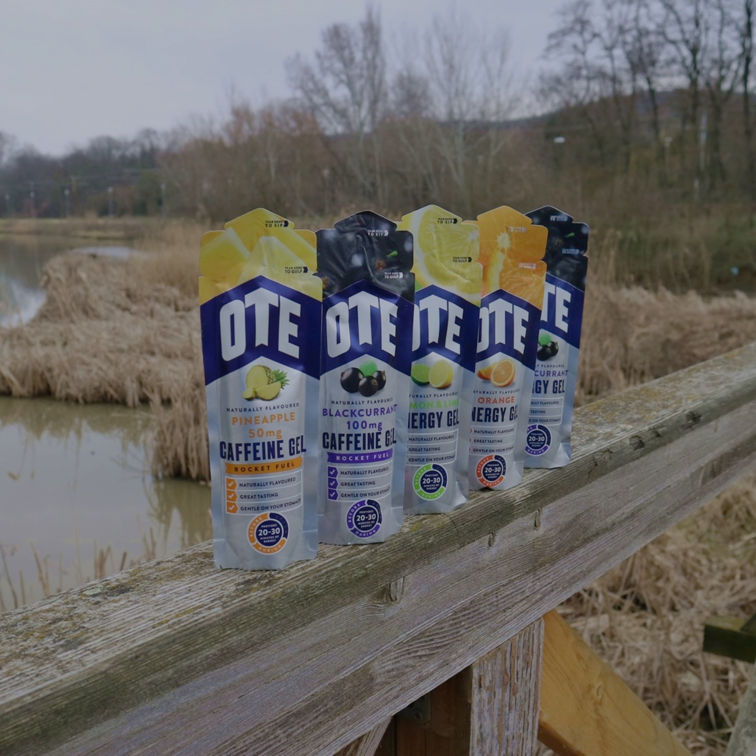
BACKGROUND
OTE Sports was founded in 2012 with a mission to change the sports nutrition market with genuine innovation based on our core beliefs:
NATURAL ENERGY – we only use natural ingredients
TASTE AND PERFORMANCE - You can have both
KIND ON YOUR STOMACH – designed to be gentle
QUALITY PRODUCTS - Not being at the expense of good value - just great products at a fair price
HONEST AND INCLUSIVE - We make sports nutrition simple and accessible to all – from amateurs to pros

Slide 32
360 PRODUCT RANGE
ENERGY & CAFFEINE GELS
ENERGY DRINKS
PROTEIN BARS
PERFORMANCE ENERGY BARS
RECOVERY DRINKS
ANYTIME BARS
SUPPLEMENTS
HYDRATION TABLETS

Slide 33
Summary and Key Actions
Nick Bishop

Slide 34
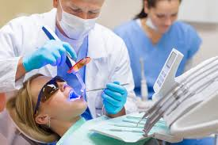
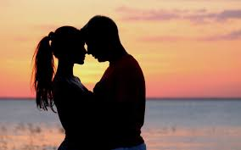
Why it works!
Words
Pictures
Feeling Emotions
Self Image

Slide 35
Wilma Rudolph…She did…You can!

Slide 36
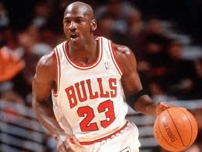
And Finally…
“Never say never because limits like fears, are often just an illusion”
MICHAEL JOHNSON

Slide 37
Running Bear…running specialists
01625 582130
www.runningbear.co.uk

